Slide 1

Lecture 1 – Introduction to Machine Learning
김지한 (카이스트)
8.20.2021

Slide 2

KAIST Molecular Simulation Lab (molsim.kaist.ac.kr)
Prof. Jihan Kim
KAIST Associate Professor
(Dept. Chemical and Biomolecular Engineering)
Research Interests
Methods: molecular simulations (DFT, MP2, Monte Carlo, molecular dynamics) and machine learning (deep learning, big data, AI)
Materials: porous materials (e.g. zeolites, metal-organic frameworks, polymers) and 2D materials (e.g. graphene, MoS₂)
Applications: carbon capture, methane/hydrogen storage, sensors, drug delivery, catalysis, water harvesting

Slide 3
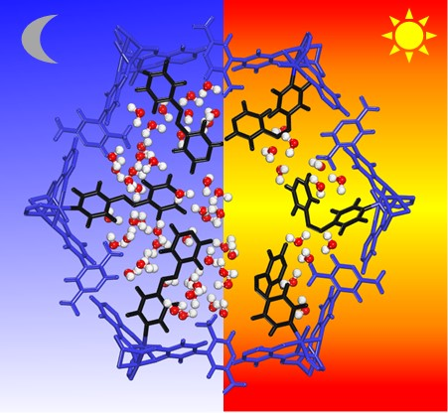
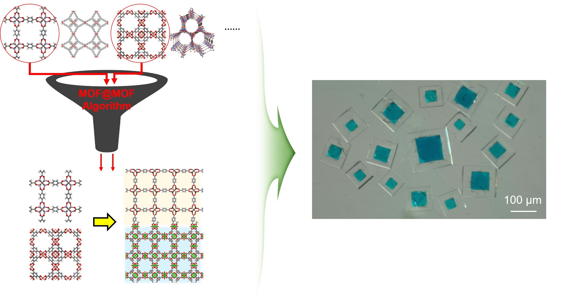
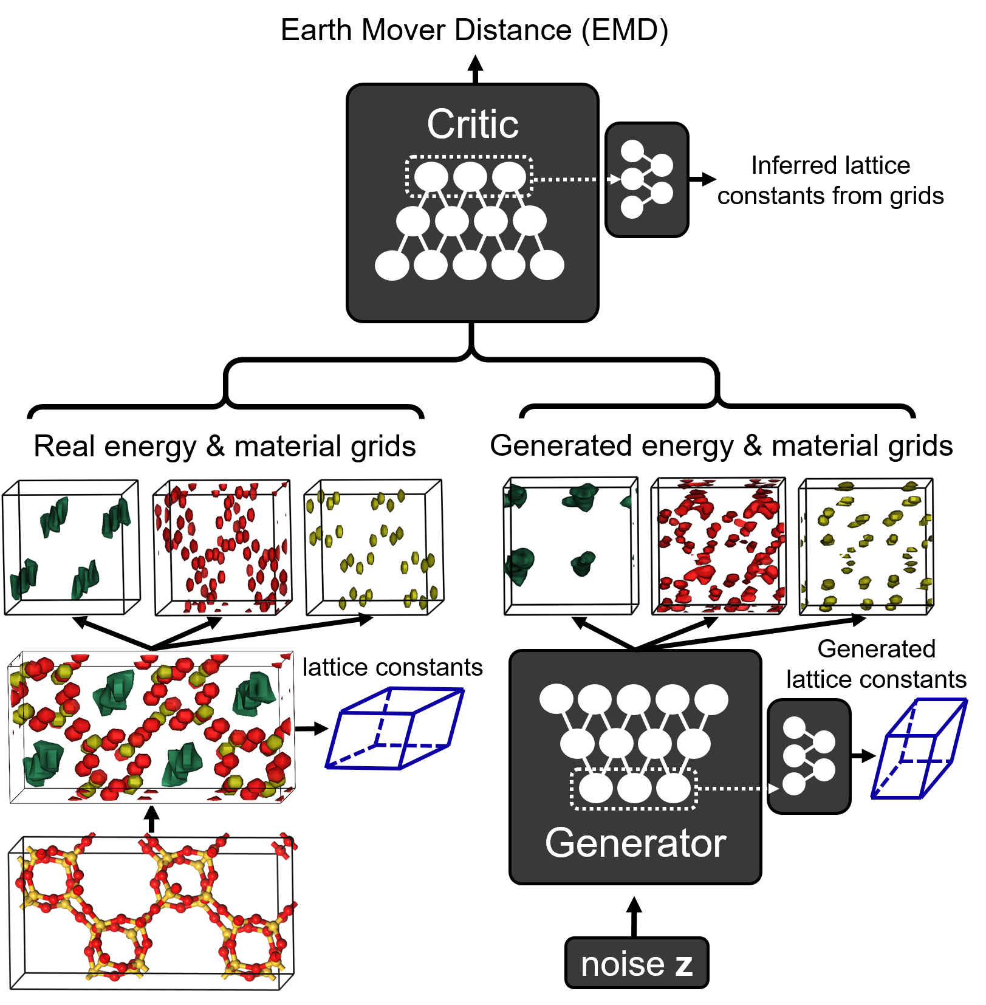
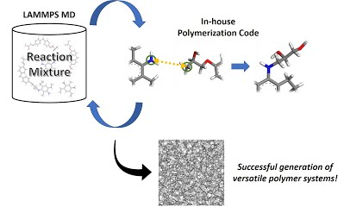
KAIST Molecular Simulation Lab (molsim.kaist.ac.kr)
1. Applications of Porous Materials
2. Next-generation Materials Genome
W. Jeong, J.Kim*, Journal of Physical Chemistry C, 2016.
B. Suh, S. Chong, J. Kim*, ACS Sustainable Chemistry & Engineering, 2019.
B. Suh, J.Kim*, Journal of Physical Chemistry C, 2018.
O. Kwon, S. Park, H-C. Zhou, and J.Kim* Chemical Communications, 2017.
S. Chong, G. Thiele, J.Kim*, Nature Communications, 2017.
O. Kwon, J. Kim, S. Park, J. Lee, J. Ha, H. Park, H. Moon*, J. Kim*, Nature Communications, 2019.
3. AI and Machine Learning in Chemical Engineering
4. Software Development for Chemical Engineers
S. Lee, B. Kim, J. Kim*, Journal of Materials Chemistry A, 2019. B. Kim, S. Lee, J. Kim*, Science Advances, 2020.
S. Chong, S. Lee, B. Kim, J.Kim*, Coordination Chemistry Reviews, 2020.
W. Jeong, D. Lim, S. Kim, A. Harale, M. Yoon, M.P. Suh, J. Kim*, PNAS, 2017.
S. Lee, J. H. Lee*, J.Kim*, Korean Journal of Chemical Engineering, 2017.
S. Park, B. Kim, S. Choi, P. Boyd, B. Smit*, J.Kim* , Journal of Chemical Information and Modeling, 2018.
3

Slide 4

Carnegie Mellon University (05/29/2018)
Carnegie Mellon has announced one of the first* AI-focused undergraduate degrees in the US to address the increasing demand for specialists in the field. Tech giants like Google have been ramping up their artificial intelligence efforts in recent years, since they've become integral in the development of machine learning techniques used for their products. …
https://www.engadget.com/2018/05/11/carnegie-mellon-undergrad-ai-degree/

Slide 5

Terminology: AI, Machine Learning, Deep Learning
As people know “the 4th Industrial Revolution” indicates that artificial intelligence is at the core of the new technology that will revolutionize mankind.
However, most are unclear at what these actually mean.
So it would be informative to first start with the definitions.

Slide 6
Terminology: AI, Machine Learning, Deep Learning
Artificial Intelligence (AI): “machines that can perform tasks that are characteristic of human intelligence” (e.g. identifying cat from a picture)
Narrow AI: does one task really well (e.g. playing go)
General AI: does multiple tasks really well (e.g. plays go well and can recognize pictures)
As can be seen, general AI is a much more difficult problem to solve and most of the research in different realms (physics, chemistry, biology, engineering) are focused on narrow AI.

Slide 7
Terminology: AI, Machine Learning, Deep Learning
Machine Learning (ML): “field of computer science that uses statistical techniques to give the computer systems the ability to “learn” with data, without being explicitly programmed.”
The easiest way to think about the relationship between AI and ML is this: with ML, you can create an AI. However, you can “in theory” create an AI without ML (in some other system).
For example, if you explicitly program everything, you are not doing ML.
There are different ways to achieve AI and ML seems to be one of the best ways to do so at the moment.

Slide 8
Terminology: AI, Machine Learning, Deep Learning
Deep Learning: deep learning is a subset of machine learning.
Specifically, it is a class of machine learning algorithms that
use a cascade of multiple layers of nonlinear processing for feature extraction
learn in both supervised and unsupervised manners
learn multiple levels of representations that correspond to different levels of abstractions

Slide 9
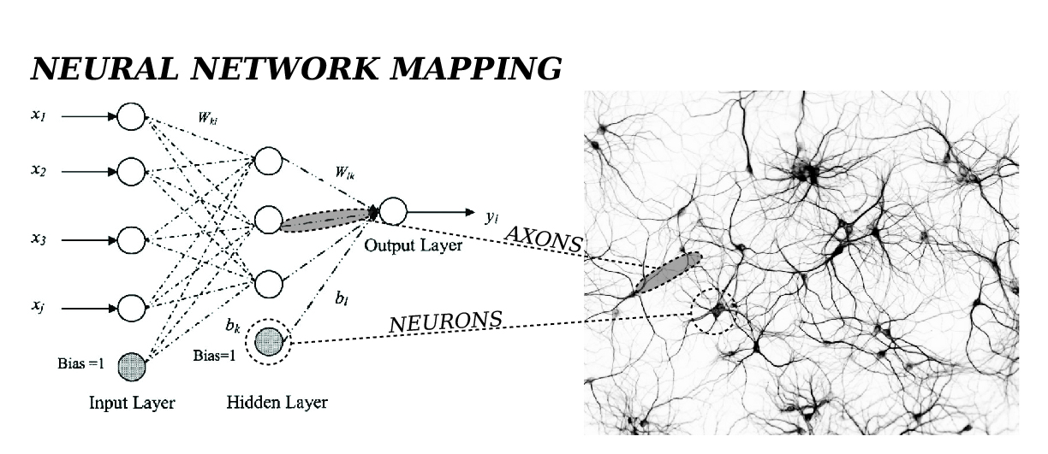
Introduction to Neural Networks
There are artificial neural networks (ANN) and biological neural networks located in brains.
The ANNs are inspired by biological network in that our brain seems to be very very good at learning certain things (recognizing patterns).

Slide 10

Biological Network
Biological network consists of neurons (see above).
When the sum of input signals into one neuron surpasses a certain threshold, it sends an electrical signal along the axon.

Slide 11
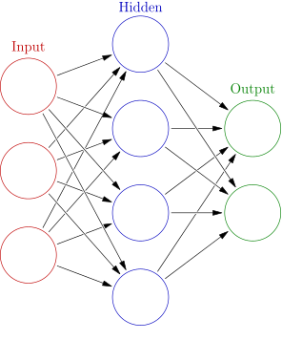
Artificial Neural Network (ANN)
Similarly, ANNs have connections such that a “signal” can be transmitted from one “neuron” to the next.
Mathematically, ANN can be seen as a complicated function that takes in an input and provides an output.
We as users decide how to use the abstractions of the inputs/outputs to the problem that we want to solve. We will see this in the example.

Slide 12
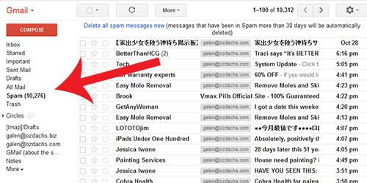
Example of Machine Learning – SPAM Filter
If you open up google e-mail (gmail), you will see that there is a section called SPAM where unwanted e-mails automatically fall.
Google uses machine learning algorithm to detect spam.
What would it look like if Google did not use machine learning??

Slide 13
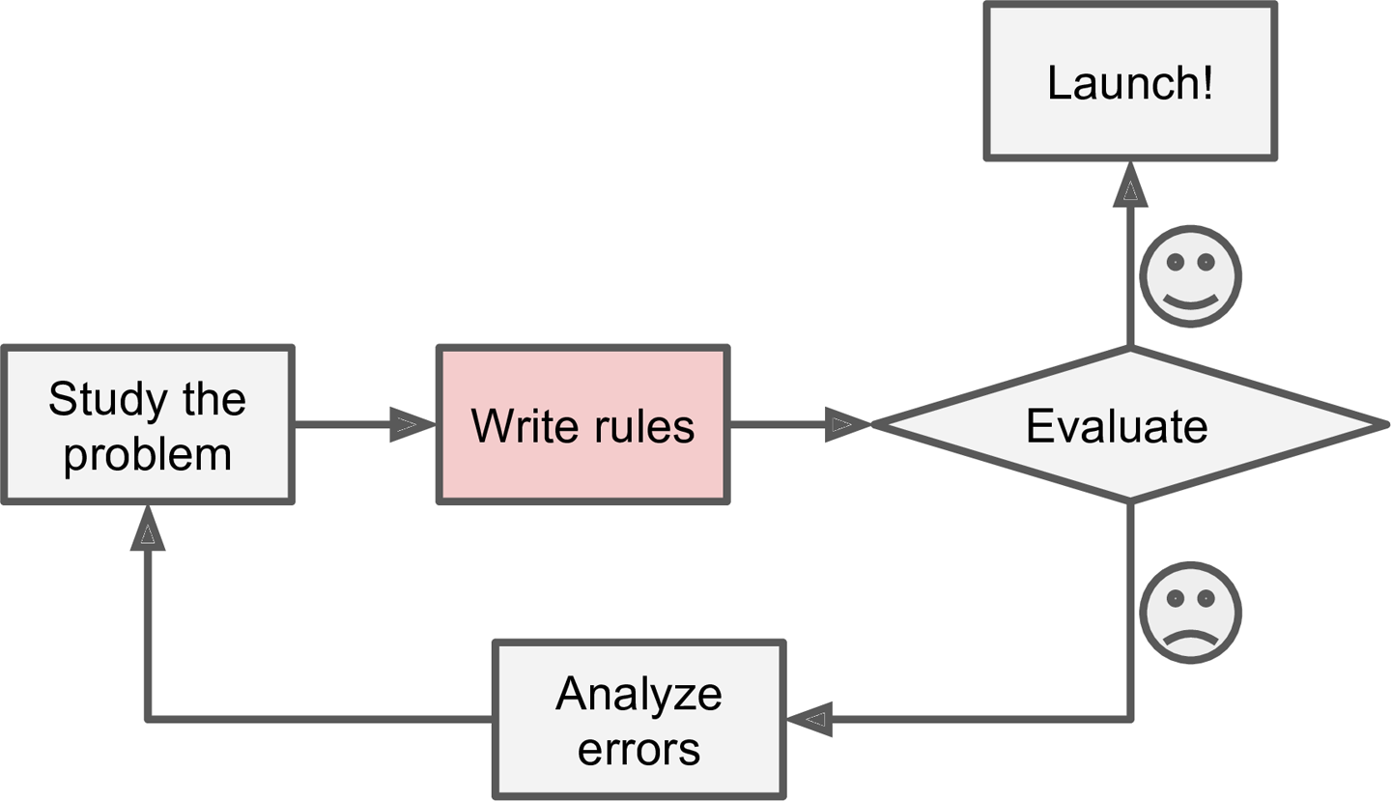
SPAM – Traditional (a.k.a. Non-Machine Learning) Approach

Slide 14
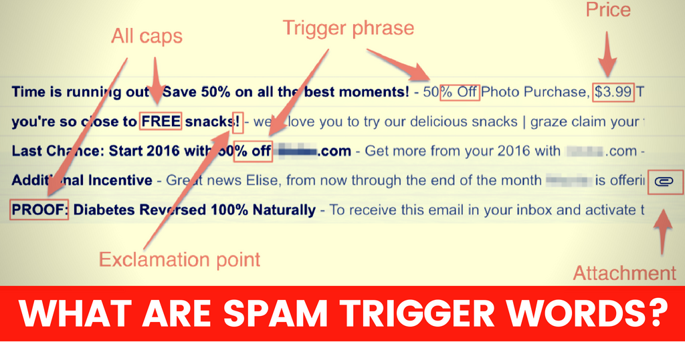
Typical Spam Message

Slide 15
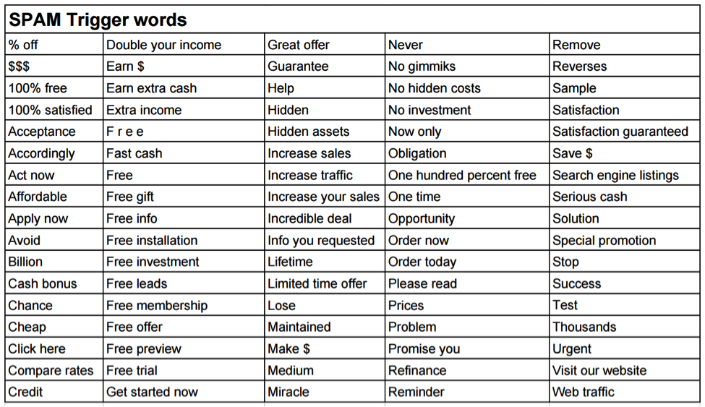
Traditional Approach to Differentiate SPAM – Write Rules
E.g. There are some common words associated with SPAM e-mails.
If many of these words are in the e-mail, mark it as SPAM.

Slide 16
Problems with Traditional Approach
Writing rules takes a lot of effort.
The rules need constant updating.
The approach is not really generalizable and needs to be manually done for all different applications.
These are “problems” in general for rule-based AI.
And this is where big data-based machine learning shines because the code is much more simpler and you don’t have to explicitly know or make the rules.
You just need a lot of data.

Slide 17
Different Types of Machine Learning Systems
1) Supervised learning
2) Unsupervised learning
3) Semi-supervised learning
4) Reinforcement learning
The differentiation between many types of machine learning systems hinges on what kind of data are available.

Slide 18
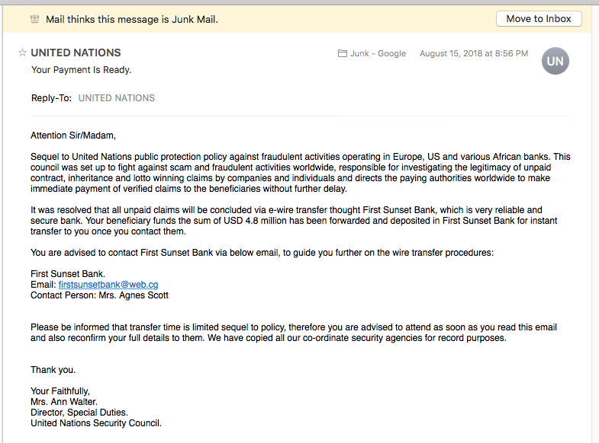
Supervised Learning
Supervised learning: the training set you feed to the algorithm contains the desired solutions (called labels).
E.g.
Label: SPAM
You are certain of the answer and can label it
Text of one e-mail (part of training set)

Slide 19
Supervised Learning
Data for Supervised Learning
In general, the “labeling” is not done by AI/machine, but by people. So this can be cumbersome to do, depending on the task (for example, see next slides on plastic recycling).
Training Set | Label
Text of E-mail #1 | SPAM
Text of E-mail #2 | Not SPAM
Text of E-mail #3 | Not SPAM
Text of E-mail #4 | SPAM
Text of E-mail #5 | SPAM
… | …
Text of E-mail #N | Not SPAM

Slide 20
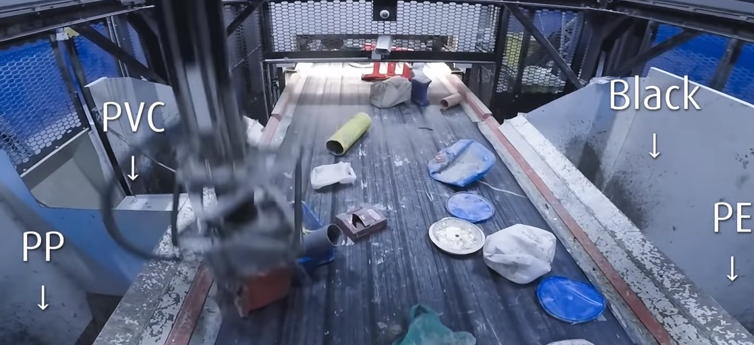
Example: Plastic Recycling
Plastic recycling is a big global issue these days.
One very important aspect of plastic recycling is “separation” where different categories of trash are binned together.
Mostly, separation is done manually, but these days, there are robots that can automatically detect (based on video) different trash categories and put them in the correct bin.

Slide 21
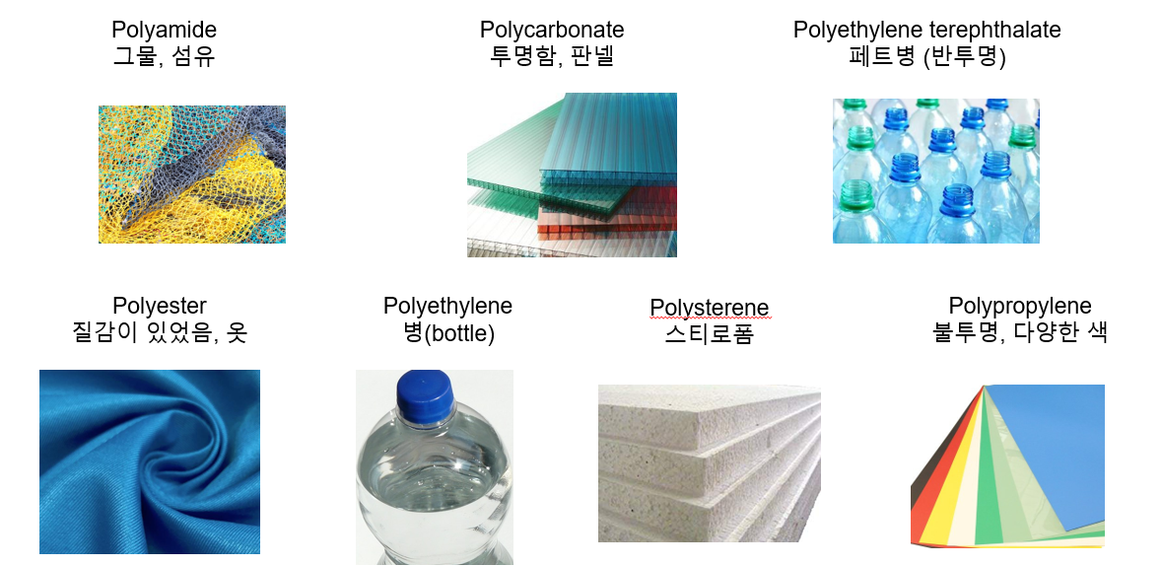
Example: Image Classification
To train the robots for classification, we need big data of trash images.
Gathering this “big data” can be difficult and can be the bottleneck of this project.
 | Plastic | Cardboard | Glass | Metal | Paper | Trash
Train | 86% | 93% | 89% | 89% | 96% | 76%
Valid | 79% | 84% | 79% | 81% | 94% | 50%
Test | 88% | 89% | 83% | 79% | 97% | 46%

Slide 22
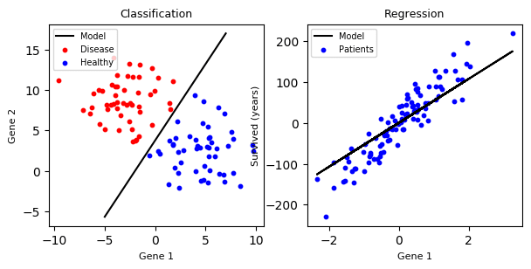
Supervised Learning – (1) Classification
Classification: organization of labeled data.

Slide 23
Supervised Learning – (2) Regression
Regression: prediction of trends in labeled data to determine future outcomes.

Slide 24
Supervised Learning – Types of Algorithms
Types of supervised learning
K-nearest neighbors
Linear regression
Logistic regression
Support vector machines (SVMs)
Decision trees and random forests
Neural networks

Slide 25
Unsupervised Learning
Unsupervised learning: the training set you feed to the algorithm does NOT contain desired solutions (i.e. no labels).
There is no teacher and the data is unlabeled.
Examples of unlabeled data (contains the data but nothing else)
Photos
Audio recordings
News articles
Tweets
X-rays
Unlabeled data can become labeled (e.g. set of photos: label to “dogs” and “cats”).

Slide 26
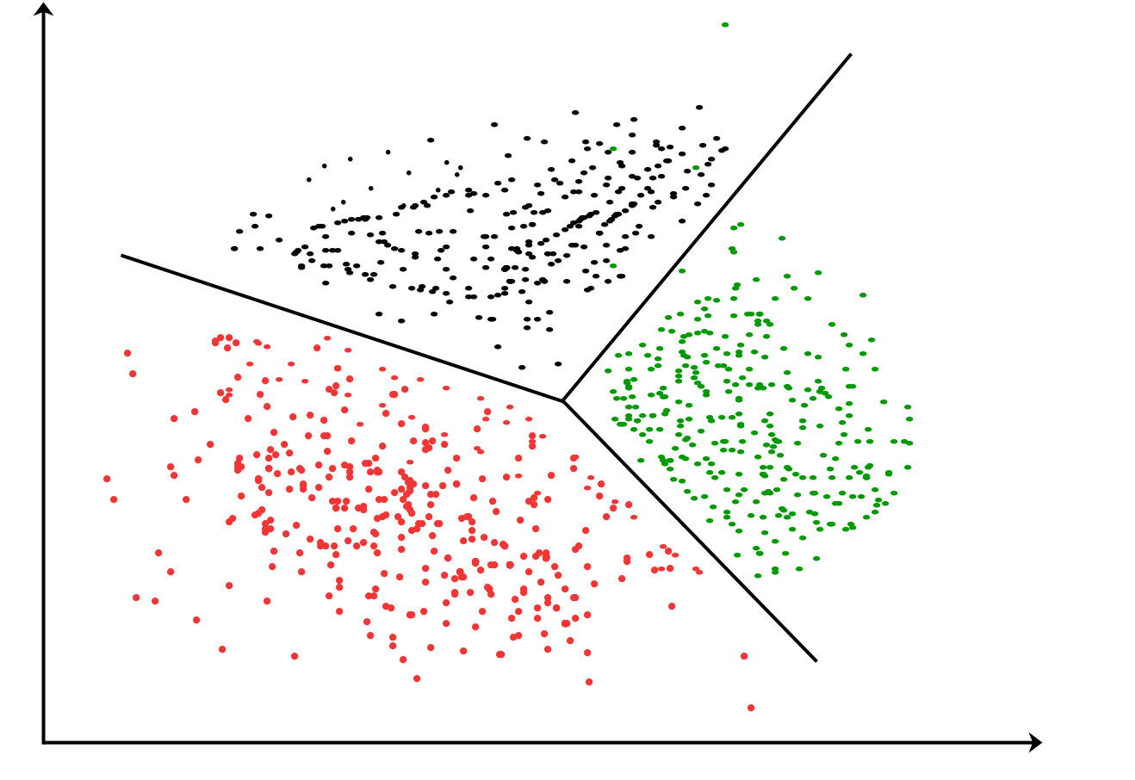
Unsupervised Learning
What can I do with unlabeled data?
In low-dimensions (e.g. two dimensions with X vs Y), one can simply plot all the data and recognize patterns (e.g. clustering) in the data.
E.g.
X | Y
X(1) | Y(1)
X(2) | Y(2)
X(3) | Y(3)
X(4) | Y(4)
…
…
X(N) | Y(N)

Slide 27
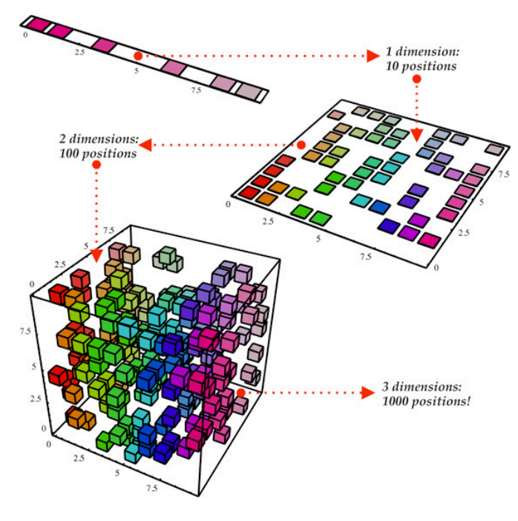
Unsupervised Learning – High Dimension Data
In the previous case, it was easy to plot and visualize the data because it was in two-dimensions.
In many cases, real data have very high dimensions, which makes it difficult to visualize and seek out patterns.
Dimensionality reduction: goal is to simplify the data without losing too much information.

Slide 28
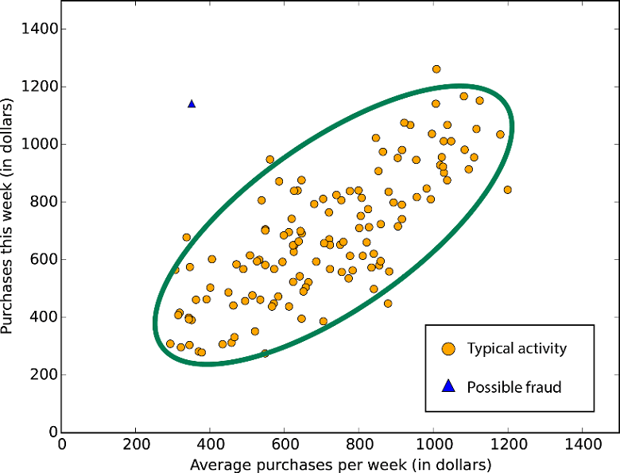
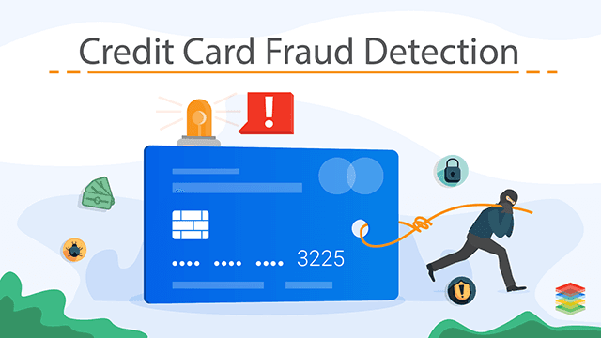
Unsupervised Learning – Anomaly Detection
Even without unlabeled data, by visualizing the data, we can see that some of them are anomalous.
As such, we can make rules to classify anomaly data versus normal data.

Slide 29
Unsupervised Learning – Types of Algorithms
Types of unsupervised learning
Clustering
Anomaly detection and novelty detection
Visualization and dimensionality reduction
Association rule learning

Slide 30
Semi-supervised Learning
In real-world data, it will often be the case that some of the data will be labeled and others won’t.
This is what is called semi-supervised learning
Example: in many photos, certain pictures might have label of you whereas others won’t. Then, based on this information, one can think about naming the photos.

Slide 31
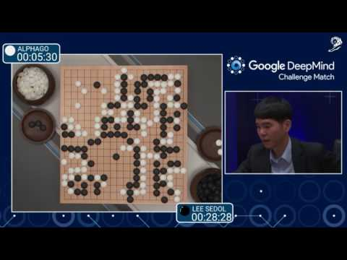
Reinforcement Learning
This is a bit different in that an “agent” can observe environment, and perform actions and tasks in return for a reward.
One develop best policies or strategies to accumulate most award over time.
Example: DeepMind AlphaGo

Slide 32
Challenges of Machine Learning #1: Insufficient Number of Data
This is very common problem where we would need a lot of data to develop a robust/accurate machine learning algorithm but have insufficient of data.
This can often be the bottleneck in starting your machine learning project.
Example: certain image or speech recognition requires millions of examples (millions of data).

Slide 33
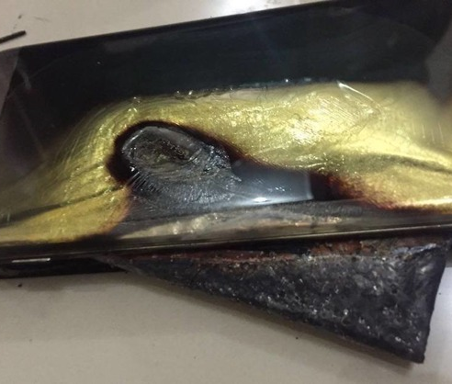
Challenges of Machine Learning #1: Insufficient Data (Example)
We would like to know the lifetime of some electronic device (e.g. cell phones).
E.g. Want to predict which cell phones will catch fire.
A typical lab cannot afford thousands of cell phones and does not have time to wait for the lifetime of each phone.
Even if they were all kept under the same condition (decreasing the number of variables), the problem is that there is too little data to note what features (there might be hundreds of them) affect lifetime.

Slide 34
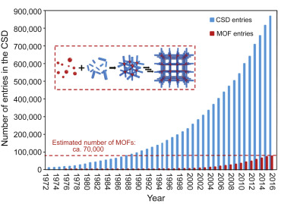
Challenges of Machine Learning #2: Non-representative Training Data
There is a common problem in that in science/engineering, we often get biased dataset in that we only see the successful cases and unsuccessful cases are not reported.
Example: successfully synthesized versus unsuccessfully synthesized materials (no one really reports failures of synthesis).

Slide 35
Challenges of Machine Learning #3: Lack of Meta Data
It might turn out that metadata (i.e. data about the data) is important.
Experimental synthesis of a material (from a paper)
Missing metadata: (1) who conducted the experiment? (2) what month/year was it? (3) what was the lab condition (temperature, humidity) like during the experiment?
These factors can all be vital for chemical synthesis.
This is important because OFTEN, synthesis is not reproducible (even in the same lab)!!
Octahedral HKUST-1 was prepared by a reported method with minor modifications⁴¹. Cu(NO₃)₂·2.5H₂O (0.472 g, 2.03 mmol) was dissolved in 6 mL of 1:1 H₂O/N,N-dimethylformamide (DMF) mixture in a 50 mL vial. Benzene-1,3,5-tricarboxylic acid (H₃BTC) (0.360 g, 1.71 mmol) was completely dissolved in slightly heated ethanol (4.5 mL) with stirring. To Cu nitrate solution, ethanolic ligand solution and glacial acetic acid (12 mL) were added and placed at 55 °C oven. After 22 h, the mother liquor quickly decanted and the blue crystals were washed with fresh ethanol. For MOF@MOF synthesis, ethanol washed HKUST-1 crystals were stored in N,N-diethylformamide (DEF) solvent.

